Slide 1


How Websites
Store Data
Lucas Augusto Hartmann

Slide 2
Storage
Methods
Cookies
Local Storage
Session Storage
CDNs
Databases
Cloud Storage
Caching
Server Files

Slide 3
Client-Side
Storage
Cookies
Small text files stored in your browser that track user sessions, preferences, and behavior. Websites use cookies to remember login states and personalize your experience across visits.
Session Storage
Temporary browser storage that holds data only for the duration of a page session. Data is automatically cleared when the browser tab closes, ideal for sensitive temporary information.
Local Storage
A web storage mechanism that saves data persistently in the browser with no expiration date. Perfect for storing user preferences, cached data, and settings that need to survive browser restarts.

Slide 4
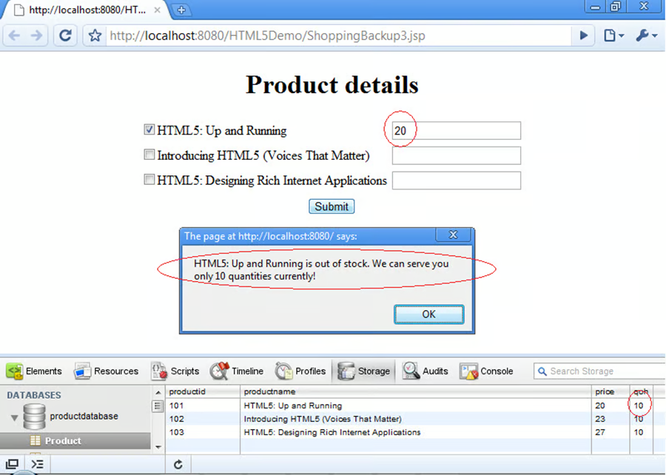
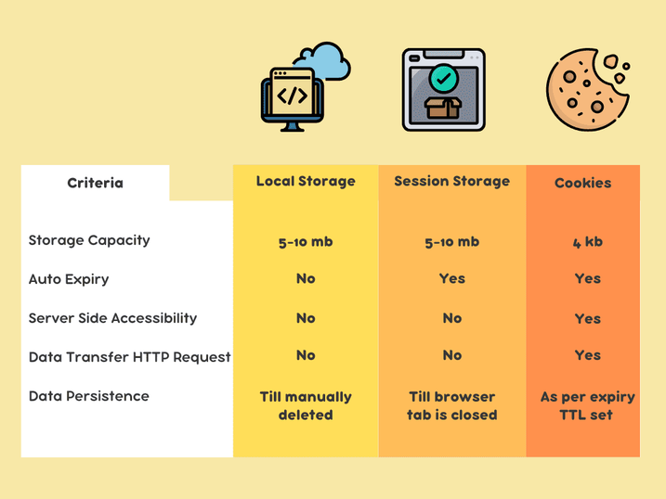
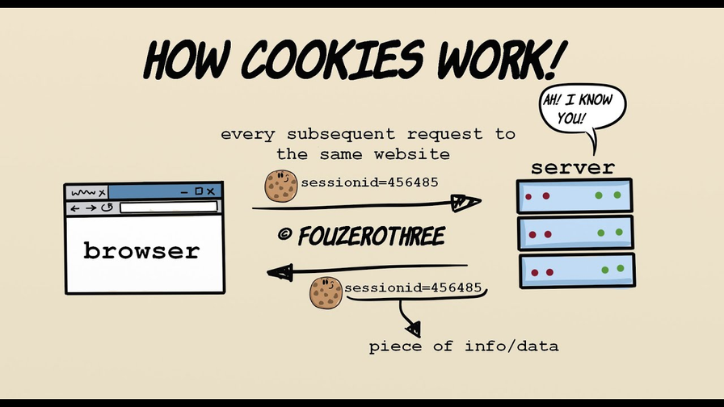
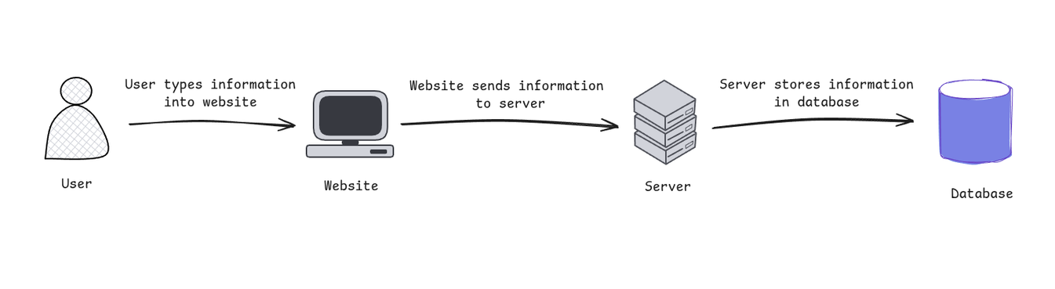

Slide 5
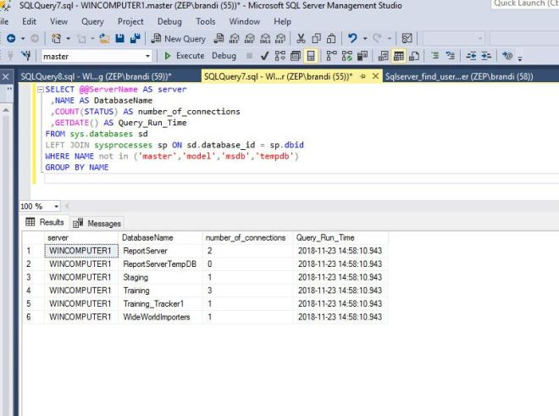
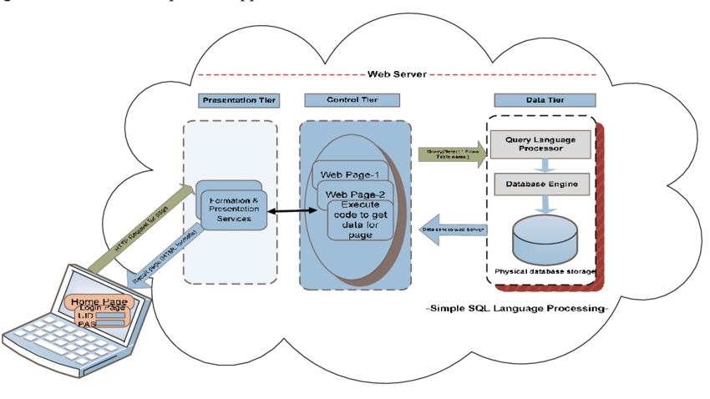
SQL
DATABASE

